Slide 1


LE Thanh Tai
10-05-2024

Slide 2

Outline
Executive Summary
Introduction
Methodology
Results
Conclusion
Appendix

Slide 3
Executive Summary
Summary of methodologies
Data collection
Data wrangling
Exploratory Data Analysis with Data Visualization
Exploratory Data Analysis with SQL
Building an interactive map with Folium
Building a Dashboard with Plotly Dash
Predictive analysis (Classification)
Summary of all results
Exploratory Data Analysis results
Interactive analytics demo in screenshots
Predictive analysis results

Slide 4
Introduction
Project background and context:
SpaceX is a leader in making space travel more accessible by offering cheaper launch costs. Their Falcon 9 rockets are advertised at a fraction of the price compared to competitors (around 62 million dollars versus 165 million or more). This affordability is largely due to SpaceX's ability to reuse the first stage of the rocket. By predicting whether a specific launch will successfully recover the first stage, we can potentially estimate the launch cost. To achieve this, we can leverage publicly available information and machine learning models to forecast SpaceX's first-stage reusability.
Problems you want to find answers:
How do variables such as payload mass, launch site, number of flights, and orbits affect the success of the first stage landing?
Does the rate of successful landings increase over the years?
What is the best algorithm that can be used for binary classification in this case?

Slide 5

Section 1

Slide 6
Methodology
Data collection methodology:
Using SpaceX Rest API
Using Web Scrapping from Wikipedia
Perform data wrangling
Filtering the data
Dealing with missing values
Using One Hot Encoding to prepare the data to a binary classification
Perform exploratory data analysis (EDA) using visualization and SQL
Perform interactive visual analytics using Folium and Plotly Dash
Perform predictive analysis using classification models

Slide 7
Data Collection
To gather comprehensive launch information for a thorough analysis, we employed two data collection techniques: SpaceX's REST API and web scraping.
SpaceX REST API provided valuable data points including flight number, launch date, booster version, payload mass, orbital path, launch site, mission outcome, number of flights the booster completed, grid fin presence, reusability status, landing legs details, landing pad used, booster block version, reusability count, booster serial number, and launch location coordinates (longitude and latitude).
Web scraping a table from SpaceX's Wikipedia entry yielded additional launch details such as flight number, launch site, payload description, payload mass, orbital path, customer information, launch outcome, booster version, booster landing status, launch date, and launch time.

Slide 8
Data Wrangling
Github URL: link

Slide 9
Data Wrangling
Describe how data were processed
You need to present your data wrangling process using key phrases and flowcharts
Add the GitHub URL of your completed data wrangling related notebooks, as an external reference and peer-review purpose

Slide 10
EDA with Data Visualization
Scatter plots are our tool to explore connections between various launch parameters. If a clear pattern emerges, these variables could be used to build a machine learning model for prediction.
Bar charts come in handy when we want to compare different launch attributes (like launch sites) and see how they relate to a specific measurement (e.g., success rate).
Line charts are ideal for visualizing trends over time. For instance, we can use them to see if SpaceX's first-stage landing success rate has improved over the years.
Github URL: link

Slide 11
EDA with SQL
Displaying the names of the unique launch sites in the space mission
Displaying 5 records where launch sites begin with the string ‘CCA'
Displaying the total payload mass carried by boosters launched by NASA (CRS)
Displaying average payload mass carried by booster version F9 v1.1
Listing the date when the first successful landing outcome in ground pad was achieved
Listing the names of the boosters which have success in drone ship and have payload mass greater than 4000 but less than 6000
Listing the total number of successful and failure mission outcomes
Listing the names of the booster versions which have carried the maximum payload mass
Listing the failed landing outcomes in drone ship, their booster versions and launch site names for the months in year 2015
Ranking the count of landing outcomes (such as Failure (drone ship) or Success (ground pad)) between the date 2010-06-04 and 2017-03-20 in descending order
Github URL: Link

Slide 12
Build an Interactive Map with Folium
I've created a map with a marker (circle) for NASA's Johnson Space Center, including a popup label and text label displaying its name. This marker's location is based on the center's latitude and longitude coordinates.
Additionally, I've added markers (circles) for all launch sites using their latitude and longitude coordinates. Each marker has a popup label and text label to identify the specific launch site. This visualization helps me understand the geographical distribution of launch sites and their proximity to the equator and coastlines.
To analyze launch success rates at different sites, I've colored the launch site markers green for successful launches and red for failed launches. Marker clusters highlight launch sites with a high concentration of either success or failure.
Finally, to visualize the surroundings of a particular launch site (e.g., KSC LC-39A), I've added colored lines to depict its distances to nearby features like railways, highways, coastlines, and the nearest city.
Github: Link

Slide 13
Build a Dashboard with Plotly Dash
To allow you to focus on specific launch sites, I've added a dropdown list where you can choose the site you're interested in.
A pie chart displays the launch success rates. When you select "All Sites," the chart shows the total successful launches across all sites. If you choose a specific launch site from the dropdown, the pie chart breaks down the success and failure rates for that particular site.
A slider that lets you adjust the payload mass range.
Finally, a scatter chart explores the relationship between payload mass and launch success rate, differentiated by booster versions. This visualization can help identify if specific booster versions perform better with heavier payloads
Github: Link

Slide 14
Predictive Analysis (Classification)
Github: Link

Slide 15
Results
Exploratory data analysis results
Interactive analytics demo in screenshots
Predictive analysis results

Slide 16

Section 2

Slide 17
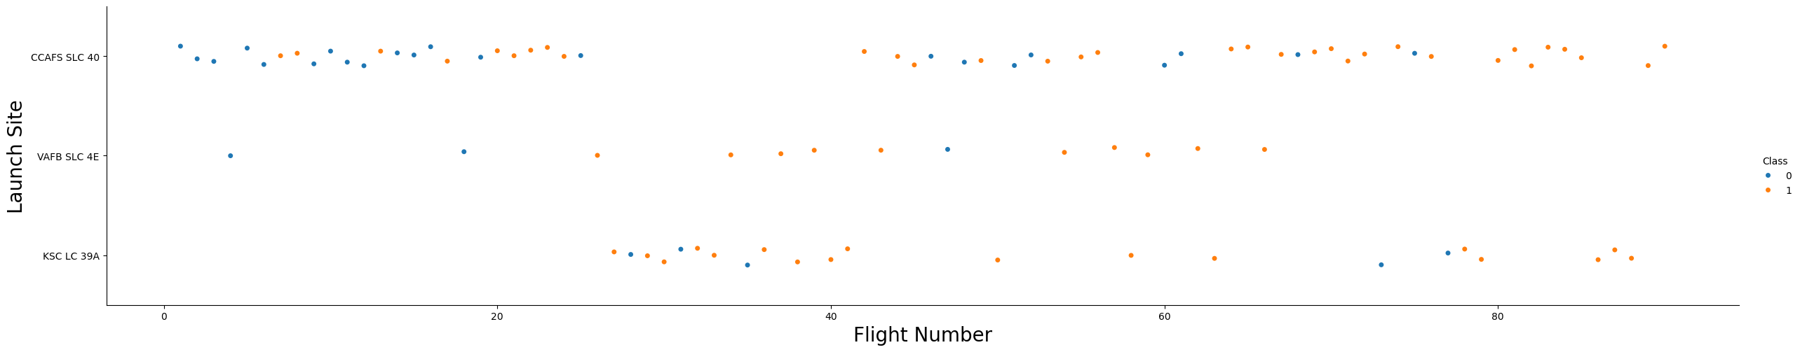
Flight Number vs. Launch Site
Early SpaceX flights faced higher failure rates, suggesting mission improvements over time.
Cape Canaveral's SLC 40 is the workhorse launch site, handling most missions.
Notably, VAFB SLC 4E and KSC LC-39A show higher success rates.

Slide 18
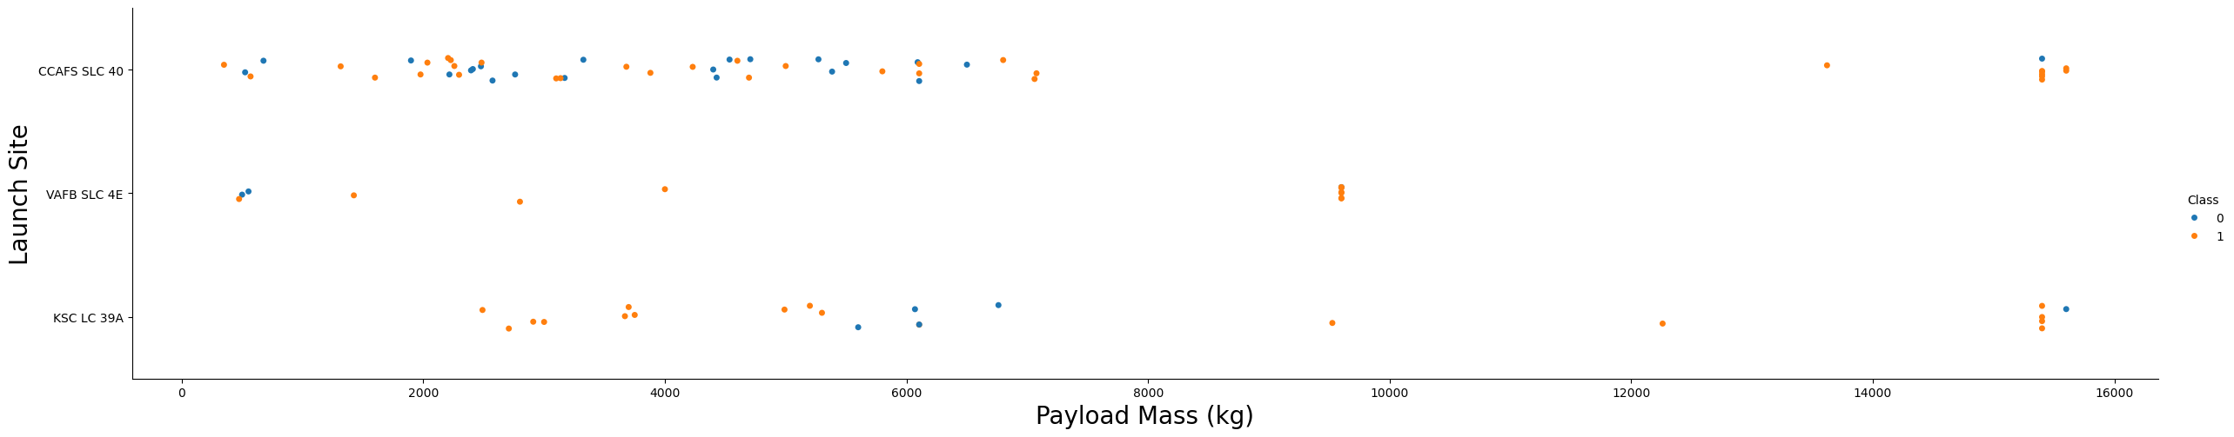
Payload vs. Launch Site
The data suggests a possible trend where success rates might increase with payload mass across all launch sites.
Launches exceeding 7,000 kg in payload mass appear to have a higher success rate overall.
KSC LC-39A seems to boast a perfect success rate for payloads under 5,500 kg. It's important to note that further analysis with more data is needed to confirm these observations.

Slide 19
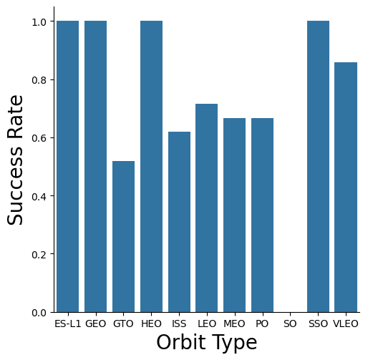
Success Rate vs. Orbit Type
00% success rate: ES-L1, GEO, HEO, SSO
0% success rate: SO

Slide 20
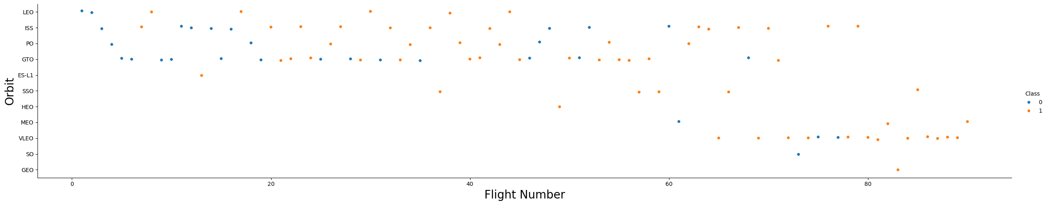
Flight Number vs. Orbit Type
Success rates in LEO may rise with a booster's flight experience, hinting at improved performance over time.
GTO missions, however, don't seem to exhibit the same link between flight number and success.

Slide 21
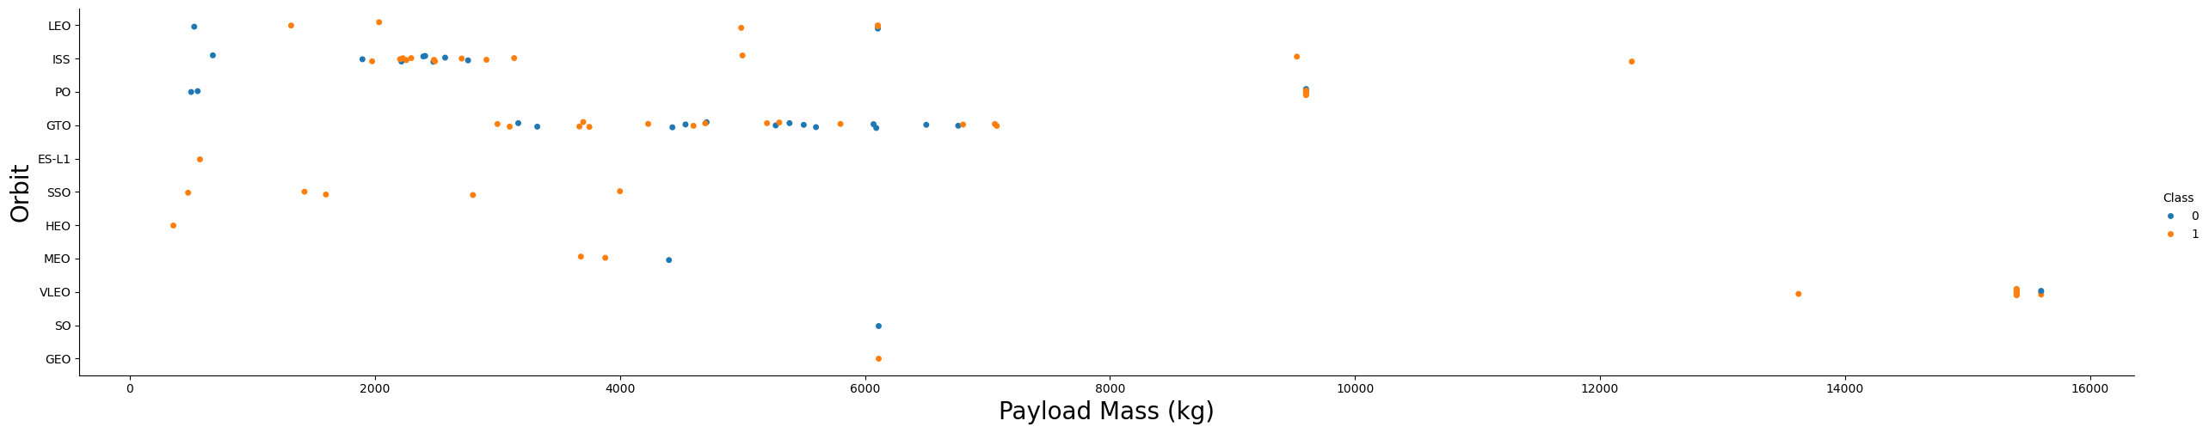
Payload vs. Orbit Type
Heavier payloads seem to hurt success rates for GTO orbits, but help in delivering cargo to the ISS (GTO & Polar LEO).
This suggests orbit type plays a role in how weight affects success.

Slide 22
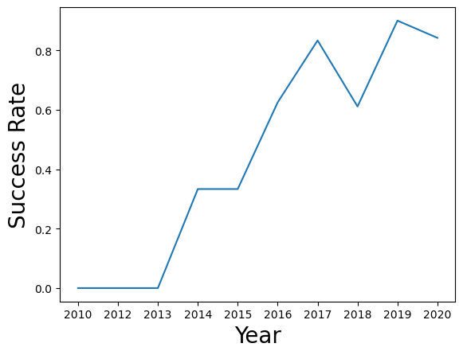
Launch Success Yearly Trend
The success rate kept increasing since 2013 until 2020

Slide 23
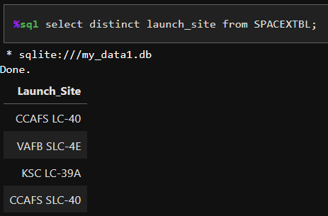
All Launch Site Names

Slide 24
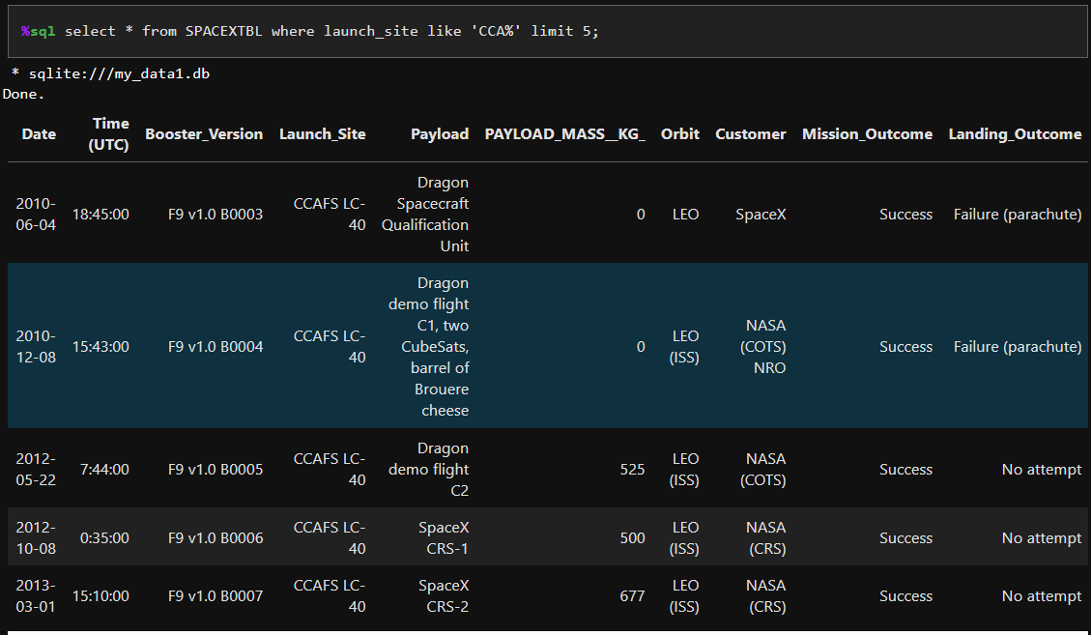
Launch Site Names Begin with 'CCA'

Slide 25
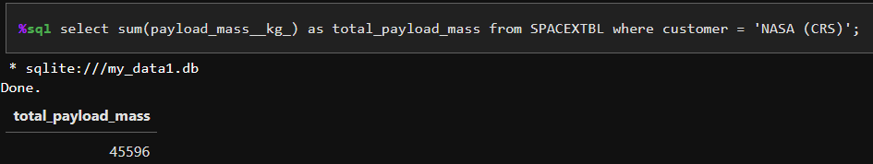
Total Payload Mass

Slide 26
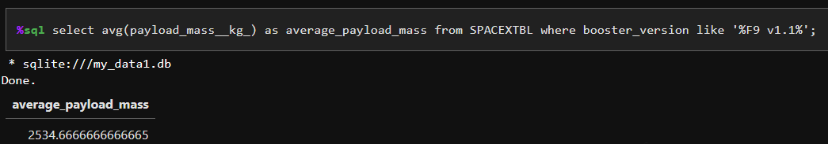
Average Payload Mass by F9 v1.1

Slide 27
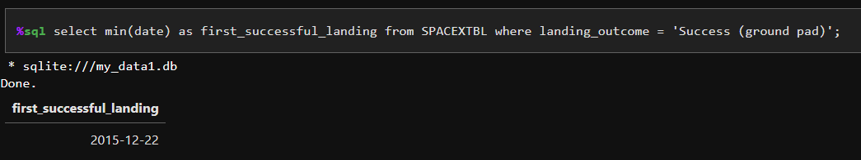
First Successful Ground Landing Date

Slide 28
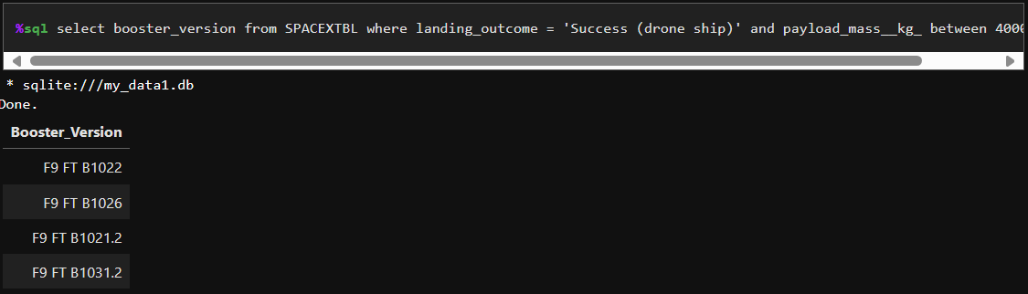
Successful Drone Ship Landing with Payload between 4000 and 6000

Slide 29
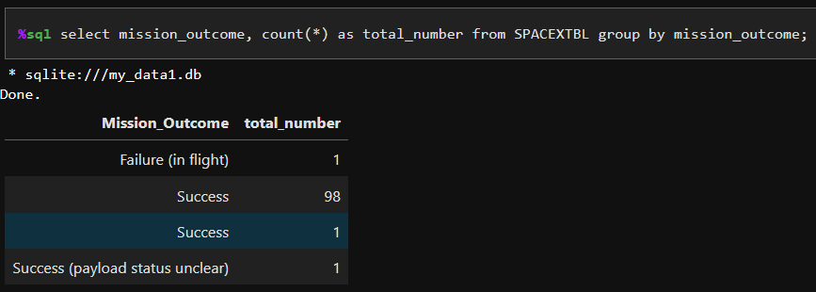
Total Number of Successful and Failure Mission Outcomes

Slide 30
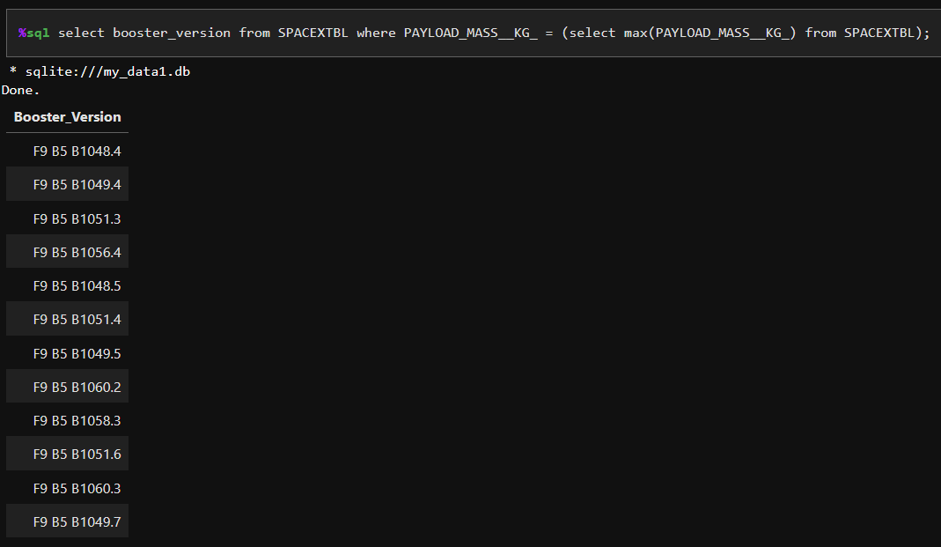
Boosters Carried Maximum Payload

Slide 31
2015 Launch Records
List the failed landing_outcomes in drone ship, their booster versions, and launch site names for in year 2015
Present your query result with a short explanation here

Slide 32
Rank Landing Outcomes Between 2010-06-04 and 2017-03-20
Rank the count of landing outcomes (such as Failure (drone ship) or Success (ground pad)) between the date 2010-06-04 and 2017-03-20, in descending order
Present your query result with a short explanation here

Slide 33

Section 3

Slide 34
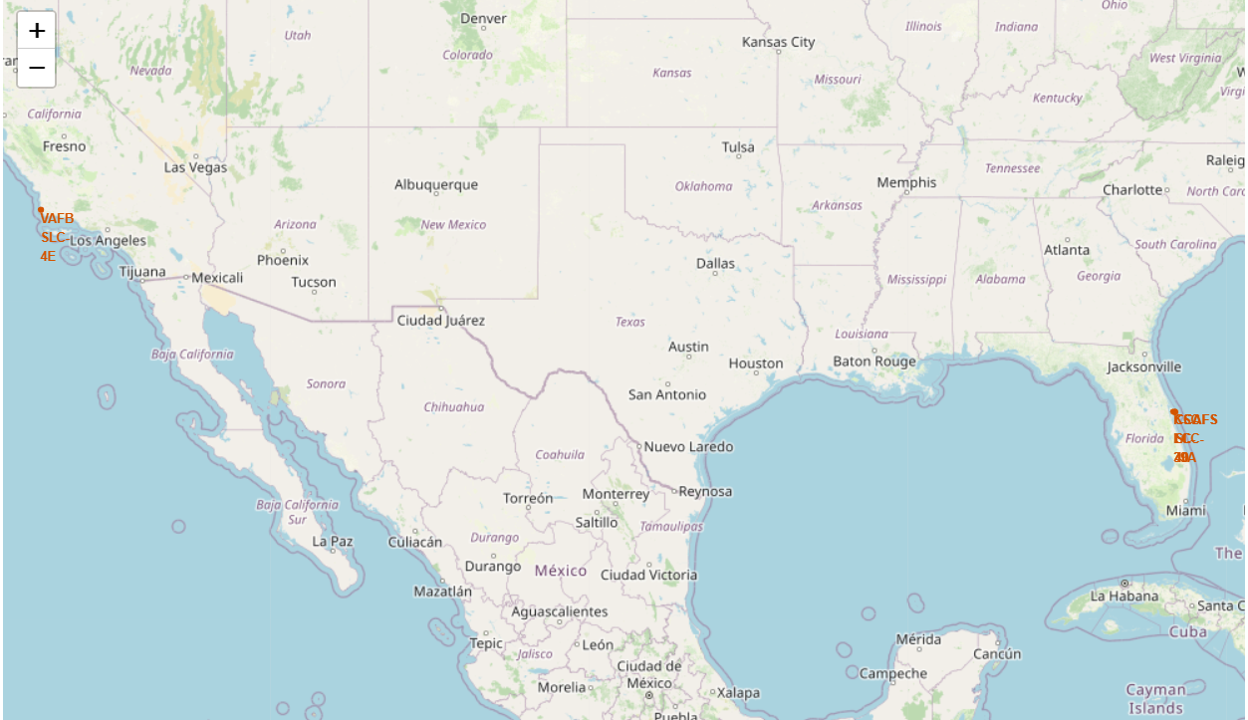
Interactive Visual Analytics with Folium

Slide 35
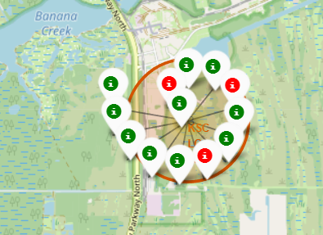
Success/failed launches

Slide 36
<Folium Map Screenshot 3>
Replace <Folium map screenshot 3> title with an appropriate title
Explore the generated folium map and show the screenshot of a selected launch site to its proximities such as railway, highway, coastline, with distance calculated and displayed
Explain the important elements and findings on the screenshot

Slide 37

Section 4

Slide 38
<Dashboard Screenshot 1>
Replace <Dashboard screenshot 1> title with an appropriate title
Show the screenshot of launch success count for all sites, in a piechart
Explain the important elements and findings on the screenshot

Slide 39
<Dashboard Screenshot 2>
Replace <Dashboard screenshot 2> title with an appropriate title
Show the screenshot of the piechart for the launch site with highest launch success ratio
Explain the important elements and findings on the screenshot

Slide 40
<Dashboard Screenshot 3>
Replace <Dashboard screenshot 3> title with an appropriate title
Show screenshots of Payload vs. Launch Outcome scatter plot for all sites, with different payload selected in the range slider
Explain the important elements and findings on the screenshot, such as which payload range or booster version have the largest success rate, etc.

Slide 41

Section 5

Slide 42

Classification Accuracy

Slide 43
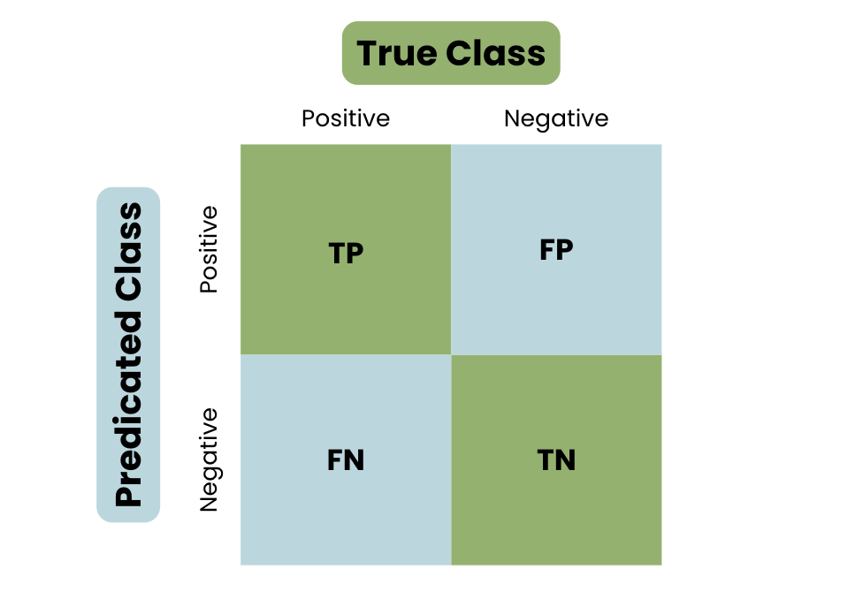
Confusion Matrix

Slide 44
Conclusions
Our analysis suggests the Decision Tree model may be the most effective algorithm for predicting SpaceX first-stage landing success based on this dataset.
Launches with lower payload mass tend to have higher success rates compared to heavier payloads.
Geographically, most launch sites are located near the equator and the coast, potentially offering launch advantages.
There's an upward trend in the overall success rate of launches over time.
Among all launch sites, KSC LC-39A boasts the highest success rate.
Interestingly, orbits like ES-L1, GEO, HEO, and SSO have a perfect success rate in the data analyzed. It's important to note that further investigation might be needed to confirm this finding with a larger dataset.

Slide 45


